Slide 1
Happiness Report
Jeff Lyng, Christopher Wecke, Han Zhao

Slide 2

Motivation & Background
In July 2011, the UN General Assembly adopted resolution 65/309 Happiness: Towards a Holistic Definition of Development inviting member countries to measure the happiness of their people and to use the data to help guide public policy. On April 2, 2012, this was followed by the first UN High Level Meeting called Wellbeing and Happiness: Defining a New Economic Paradigm, which was chaired by UN Secretary General Ban Ki-moon and Prime Minister Jigme Thinley of Bhutan, a nation that adopted gross national happiness instead of gross domestic product as their main development indicator.
The rankings of national happiness are based on a Cantril ladder survey. Nationally representative samples of respondents are asked to think of a ladder, with the best possible life for them being a 10, and the worst possible life being a 0. They are then asked to rate their own current lives on that 0 to 10 scale. The report correlates the results with various life factors.
real GDP per capita
social support
healthy life expectancy
freedom to make life choices
generosity
perceptions of corruption
Source: Social Environments for World Happiness (2020)

Slide 3

Metrics & Data
What’s in our project
o Two World Happiness csv data files from Kaggle.com for 2018 and 2019 data that included 300+ records total.
Python Flask-powered app, HTML/CSS, JavaScript and an SQLite database to present the data.
Map: We used Anychart js library to create a global choropleth map that can be used to view and compare the happiness score for all countries individually or by rating groups.
Scatter plot: We used D3.js to create an interactive scatter plot graph to compare each variable to the overall happiness score to determine any data trends
Raw data: We also create a data chart to show the data for the top 10 countries and to allow the user to select and compare the scores of multiple selected countries.
Libraries
Anychart.js
d3.js

Slide 4
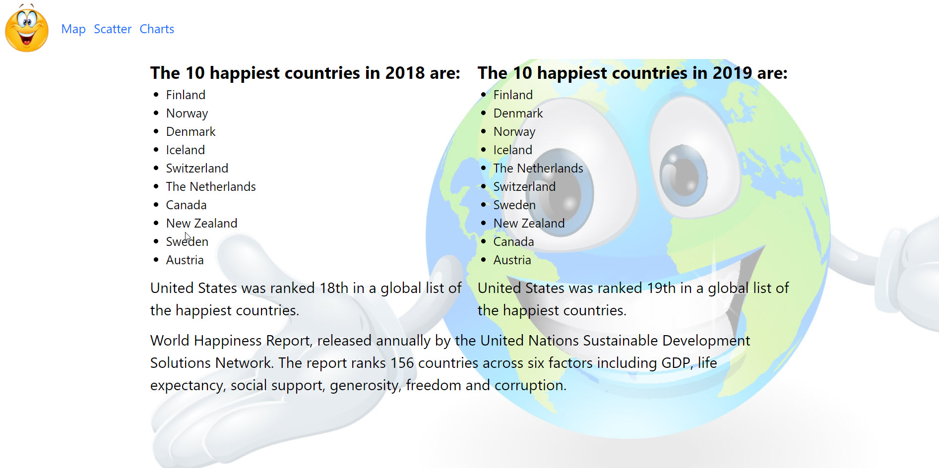
Home Page

Slide 5
Map
Source: Link

Slide 6
Scatter

Slide 7
Charts

Slide 8

Moving forward...
Combine all visualizations on one page and coordinate colors on all three
Add region filters, specific country selector, ability to compare selected countries
Run correlation on happiest/unhappiest countries
Use ‘real’ data to analyze trends (ex: actual GDP per capita)
View changes over time (ex: “Did US increase happiness score from 2015 to 2019?”)
If so, why?

Slide 9
Backup Slides
Biggest YoY Changes:
Happiness Score (Increase): Burundi +29.95%
Happiness Score (Decrease): South Sudan -12.32%
2019 GDP Social Life Freedom Generosity Corruption
USA 1.433 1.457 0.874 0.454 0.28 0.128

Slide 10
Backup Slides
The seventh and final segment in each bar is the sum of two components. The first component is a fixed number representing our calculation of the 2017-2019 ladder score for Dystopia (=1.97). The second component is the average 2017-2019 residual for each country. The sum of these two components comprises the right-hand sub-bar for each country; it varies from one country to the next because some countries have life evaluations above their predicted values, and others lower. The residual simply represents that part of the national average ladder score that is not explained by our model; with the residual included, the sum of all the sub-bars adds up to the actual average life evaluations on which the rankings are based.

Slide 11
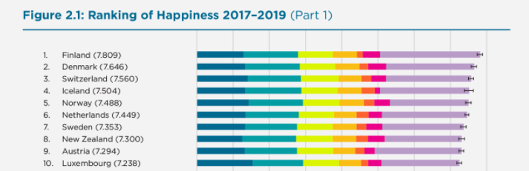
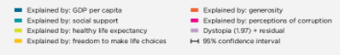
Backup Slides

